Slide 1

Event Handling in Web Technologies
Event handling is a crucial aspect of web development that allows websites to respond to user interactions and dynamic changes. This presentation explores the core principles of event handling and how they empower developers to build interactive and responsive web experiences.

Slide 2

Introduction to Event Handling
Event handling is the process of responding to events that occur in a web application. These events can include user actions, such as mouse clicks or keyboard input, as well as system-generated events, such as page loads or window resizes.
1
User Interactions
2
System Events
Events triggered by user actions like mouse clicks, key presses, and form submissions.
Events triggered by the browser or operating system, such as page loads, window resizes, and network errors.
3
Dynamic Changes
Events triggered by changes in the DOM, such as element additions, removals, or modifications.

Slide 3

Event Types and Properties
Each event type has a set of properties that provide additional information about the event. These properties can be accessed through the event object, which is passed as an argument to the event handler function.
Event Type
Description
click
Triggered when the user clicks a mouse button.
mouseover
Triggered when the mouse pointer enters an element.
keydown
Triggered when the user presses a key on the keyboard.
submit
Triggered when a form is submitted.

Slide 4
Event Listeners and Handlers
Event listeners are functions that are attached to elements and wait for specific events to occur. When an event occurs, the corresponding event handler function is executed, allowing developers to define how the application should respond.
Event Listener
Event Handler
The function responsible for attaching an event handler to an element.
The function that is executed when the event occurs.
function handleClick(event) {
// Handle the click event
}
element.addEventListener("click", handleClick);

Slide 5
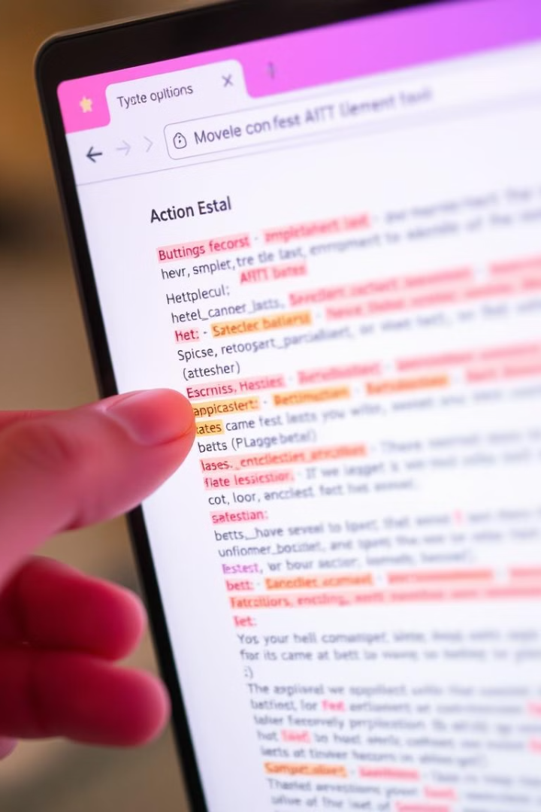



Event Propagation and Bubbling
Event propagation describes the order in which events are handled when they occur within a nested hierarchy of elements. Bubbling is the default behavior, where the event propagates from the innermost element to its ancestors.
Click on Child Element
Event originates from the child element.
Event Bubbles Up
The event propagates to parent elements.
Event Handlers Execute
Event handlers on each ancestor element are executed.

Slide 6
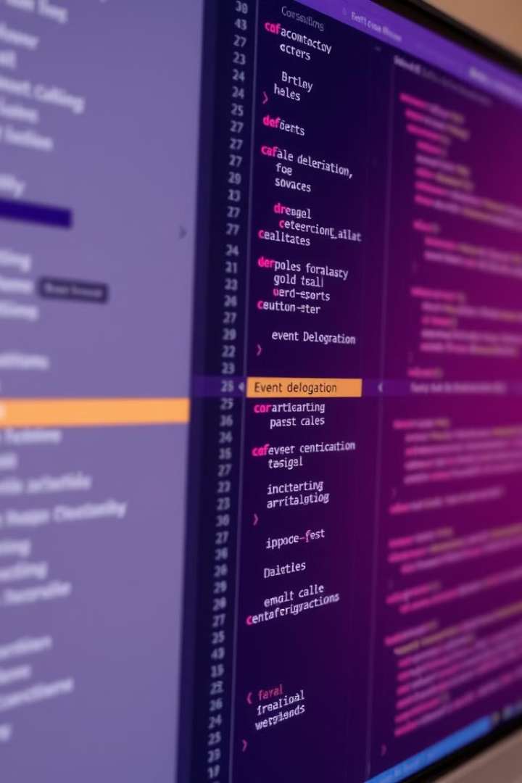
Event Delegation
Event delegation is a technique that allows you to attach event listeners to parent elements and handle events for their descendants, without needing to attach listeners to each individual child element.
Reduced Code
Dynamic Elements
Fewer event listeners improve performance.
Handles events for dynamically added elements.
Efficient Event Handling
Centralized event management for a group of elements.

Slide 7




Handling User Interactions
Event handling enables developers to create interactive web experiences by responding to user actions. This involves capturing events like mouse clicks, key presses, form submissions, and touch gestures.
Click Events
Keyboard Events
Form Events
Respond to mouse clicks on elements like buttons, links, and images.
Handle key presses for navigation, form input, and user interaction.
Process form submissions, validate user input, and handle data submission.

Slide 8
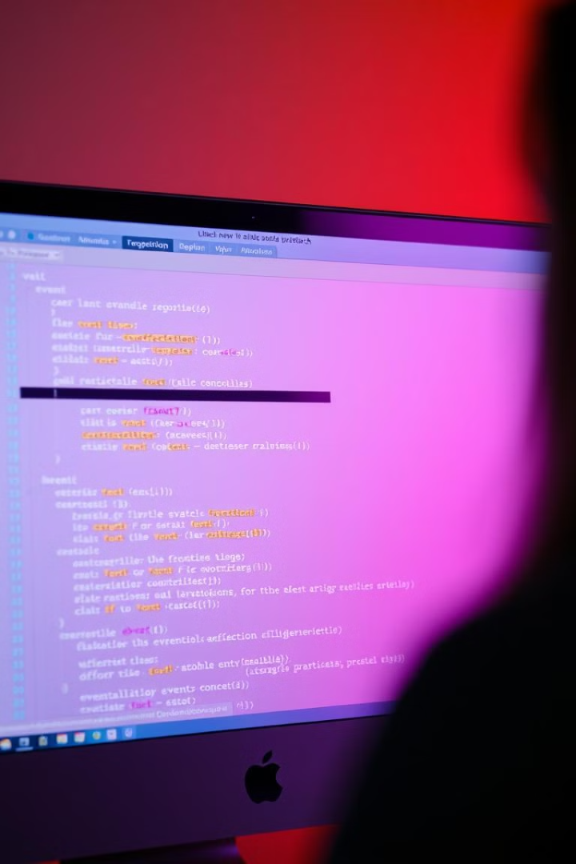
Best Practices and Troubleshooting
Effective event handling relies on adhering to best practices and addressing potential issues. Follow these guidelines to enhance the reliability and responsiveness of your web applications.
1
Prevent Default Behavior
Use `event.preventDefault()` to prevent the default behavior of certain events, like form submission.
2
Event Listener Removal
Remove event listeners when they are no longer needed to avoid memory leaks and unexpected behavior.
3
Capture Phase
Use `addEventListener` with the `capture` option to handle events before they bubble up the DOM tree.

